Slide 1
Interpretable, highly accurate brain decoding of subtly distinct brain states from fMRI using intrinsic functional networks & LSTM
By Hongming Li and Yong Fan From UPenn
PRESENTATION BY FLYN SEQUEIRA

Slide 2

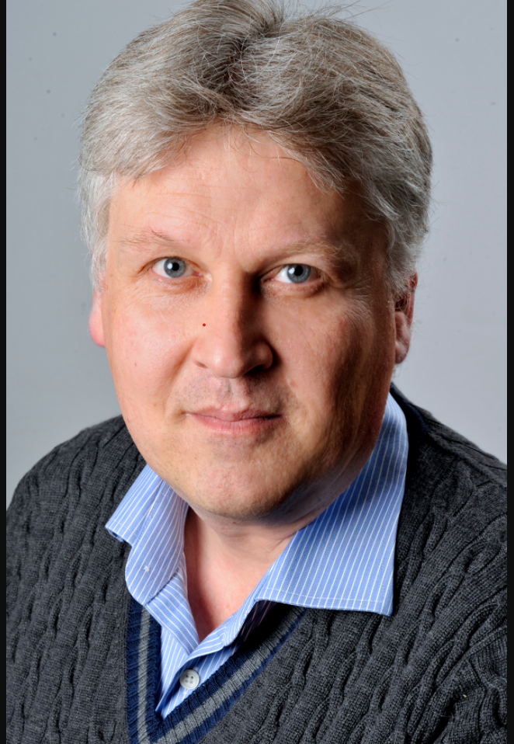

Long Short Term Memory
Or LSTM is a special kind of RNN BUT can learn long-term dependencies
Sepp Hochreiter(left) & Jurgen Schmidhuber (Right)
From Germany and Switzerland respectively
Check out the TEdX talk by Jurgen Schmidhuber with this QR Code

Slide 3

RNN

Slide 4


LSTM

Slide 5

There is this Conveyor Belt
Minor Interaction
Information Flows easily with minimal changes

Slide 6


Slide 7


Slide 8
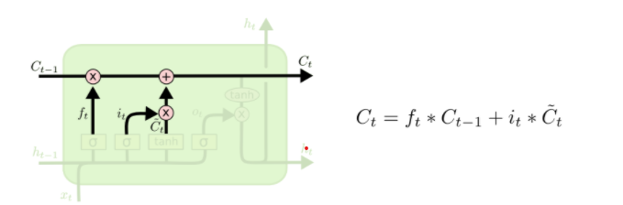

Slide 9


Slide 10
WHY LSTM RNN for fMRI data
Earlier brain decoding models analyzed functional signatures at
Individual Time Points
Fixed length Time Window
E.g. SVM & Logistic Regression used the functional signatures at an individual timepoint
Sequential fMRI data inherently has temporal dependencies. Utilizing it improves brain decoding performance
Fixed Length Time window improved the performance over individual Time Point, BUT

Slide 11
Variable length Time Window is BETTER
Because …. Brain states may change at unpredictable intervals THEREFORE Long Short Term Memory RNN.

Slide 12
Advantage of LSTM RNN
Better performance of Sequential Modelling
Doesn’t require Fixed number of timesteps
So far given better performance for Intra Subject EEG and ECoG brain decoding models
CAN be adopted for Classification and Modelling Functional Dynamics of fMRI data
Issue – Never applied for large Cohorts

Slide 13
This Paper’s GOAL
Decode brain state from fMRI data.
Learn Mapping between functional signatures and brain states, with LSTM MORE SPECIFICALLY…
Predicting brain states based on working memory fMRI data from HCP dataset
Also showed promising results for decoding Motor and Social Cognition Tasks

Slide 14
Framework
LSTM is train based on Functional Signatures using Functional brain decomposition technique

Slide 15
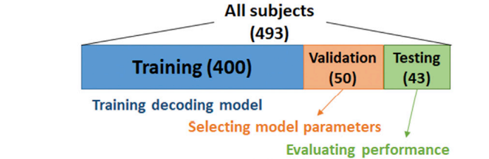
Imaging Dataset
493 Subjects from HCP
Task fMRI data were used to build and evaluate proposed decoding framework
Corresponding Resting state fMRI data were used to obtain subject specific intrinsic functional networks (FNs)
Focus of this study
WORKING MEMORY
MOTOR TASKS
SOCIAL COGNITION TASKS

Slide 16
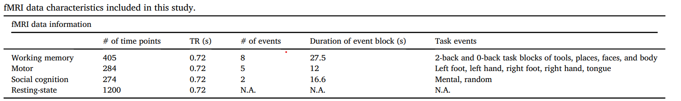
Dataset Split
TR – Time Rate in Seconds for each Time Point
Events – Events that stimulate the working Memory
Duration of each event blocks
n-Back Task Measure: paradigm to assess Working Memory

Slide 17
Feature Extraction
We use Functional networks to extract functional signatures of brain state decoding
3D fMRI data could represent by a low-dimensional feature vector
Applicable to different brain decoding tasks
Provide better interpretability
Instead of ROI at group level -> collaborative sparse brain decomposition model

Slide 18
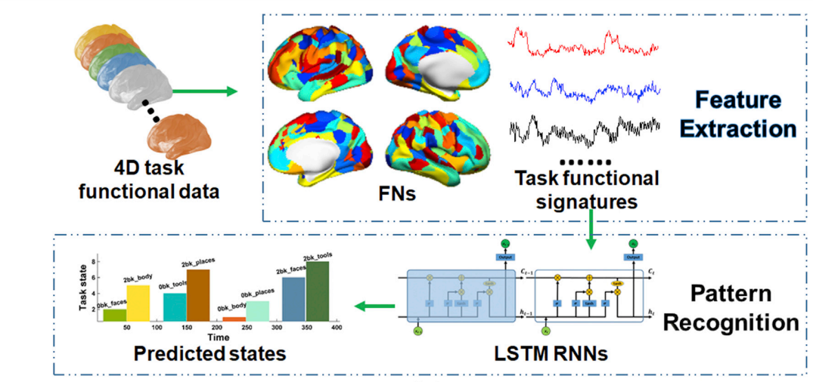

Slide 19
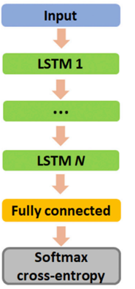
Pattern Recognition: LSTM
Functional signatures for n subjects where i = 1…n We use LSTM (The original model discussed above) to predict brain state at each timepoint. Two things are considered
Functional Profile
Dependence on previous time points
The layers include
2 Hidden LSTM Layers – To encode functional information with temporal dependency
1 Fully connected Layer – To map between learned feature representation and brain states

Slide 20
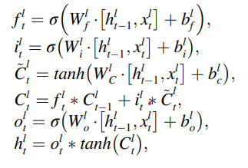
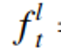
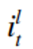
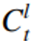
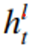
Functional representation encoded in each LSTM Layer
Output of forget gate
Input Gate
Hidden gate
Cell state
And input feature vector of l-th LSTM layer (l = 1,2)

Slide 21
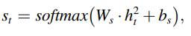
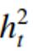
Still an Equation Slide …
Input features of first LSTM network are Functional Network signature
Input of second LSTM layer is the hidden State Vector from the first LSTM network.
Fully Connected layer has S output – Corresponing to the number of Brain states
Softmax converts these values to a probability of which state it might be
is the hidden state output of the second LSTM layer which encodes input functional signature at t-th time point

Slide 22
Optimizer
Softmax Crossentropy – It is the standard optimizer used to classify with softmax activation in the last layer
The softmax crossentropy is taken between real and predicted brain state and used as objective function to optimize the LSTM RNN Model.

Slide 23
Preprocessing Steps
Collaborative Sparse Brain Decomposition Model to resting fMRI
Number of FNs were determined based on resting-state fMRI data using MELODIC’s LAPS criteria – Decomposition using cortical surface area and NO white matter, ventricle, etc.
Each subjects fMRI data had 3 matrices
405X90 – Working Memory
284X90 – Motor Tasks
274X90 – Social Cognition Tasks
Magnitudes normalized using z-score and Input into LSTM RNN

Slide 24
Validation
5 fold Cross Validation
ISSUE: delay in Blood Oxygen Level Dependent (BOLD) response => Response not synchronized with presentation of Stimuli
Solution: Brain State adjusted to BOLD delay (6 seconds or 8 Time Points. Remember 0.75 seconds is 1 timepoint)

Slide 25
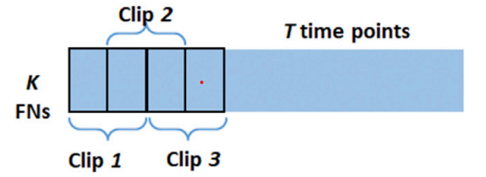
Training
20 Time points overlapped in 40 Clips
PURPOSE
Data Augmentation
To avoid same output all the time based on ground truth
Why? Ground truth is the same for most subjects.

Slide 26
Library Used - Tensorfow
Optimizer – ADAM
Learning Rate – 0.001 with Decay 0.1 at every 50k steps
Training Steps 200,000
Batch size – 32

Slide 27
Parameters Tested on
Number of Hidden Layers – {1,2,3}
Number of nodes in Hidden Layers - {32, 64, 128, 256, 512, 1024}
The optimal value among these are selected based on their performance with validation dataset
Parameter selection was done on Working Memory Task fMRI data only.
Selected parameter used for all other experiments without any more optimization.
WHY? Avoid overfitting towards better results.

Slide 28
Random Forest
Results compared with

Slide 29
Investigating what the LSTM encoder did
Investigate association between 2nd hidden LSTM cell and brain state.
How? Comparing Matrix Representation of
128 hidden cells of LSTM layer – (Rows)
Time Point – Column
The hidden cell rows were sorted on absolute weight of corresponding weights of trained prediction model.
WHY? All the high impact LSTM cells would be on top, and easier to investigate.
Then the maximum correlated LSTM cells can be identified for each task.

Slide 30
Performance Evaluation
Removed Temporal dependency
Decoding performance at each time point
Subjects in-scanner performance and involvement level

Slide 31
Does it work without temporal dependency?
Randomly jumble data along temporal dimensions.
No temporal dependency was obtained by LSTM
Therefore Prediction Performance decreased

Slide 32
Sensitivity of Functional Networks (FN)
Principal Component Analysis (PCA) based Sensitivity Analysis
For 43 test subjects – 90 FN’s signatures were set to 0, one by one.
For each set to 0, we obtained a change in decoding accuracy.
Therefore change in decoding accuracy can be represented as a matrix of 90 X 43]
This is passed through PCA to obtain Principal components (PC)
This encodes main direction of prediction changes w.r.t. functional signatures.
Sensitivity analysis was carried out on working memory, motor and social cognition tasks.

Slide 33
Principal Component Analysis
Purpose – Dimensionality Reduction
Reduces dimensionality of dataset with large set of variables to smaller set of variables that has most of the information.
Principal components are new variables that are constructed as linear combinations or mixtures of the initial variables.

Slide 34

PCA
These combinations are done in such a way that the new variables (i.e., principal components) are uncorrelated and most of the information within the initial variables is squeezed or compressed into the first components.
So, the idea is 10-dimensional data gives you 10 principal components, but PCA tries to put maximum possible information in the first component, then maximum remaining information in the second and so on, until having something like shown in the scree plot below.

Slide 35
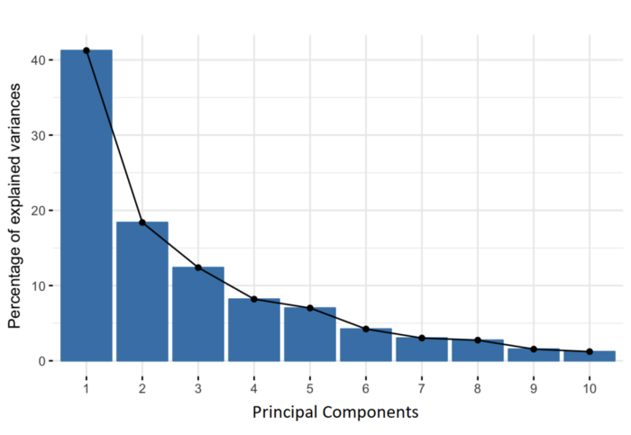

Slide 36
Problem
An important thing to realize here is that, the principal components are less interpretable and don’t have any real meaning since they are constructed as linear combinations of the initial variables.

Slide 37
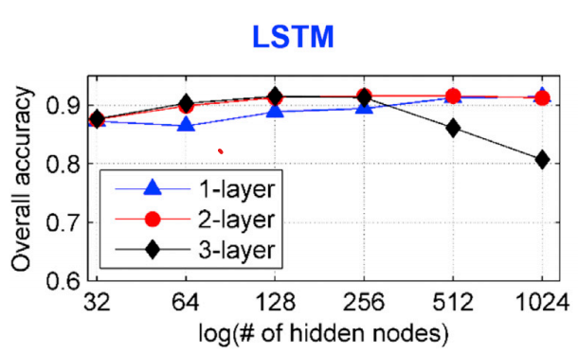
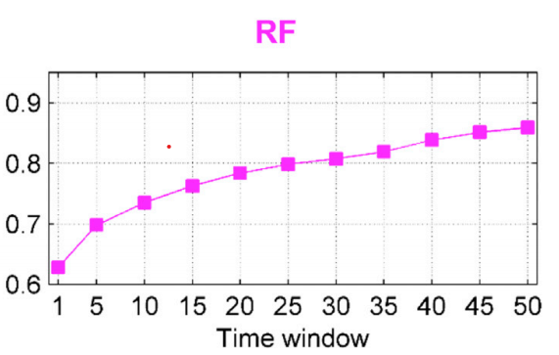
Results
Accuracy was optimal with 2 hidden layer
3 hidden layers created overfitting and reduced accuracy.
RF had fixed time window. Longer time-window gave better performance – Optimal time-window – 40 time points.

Slide 38
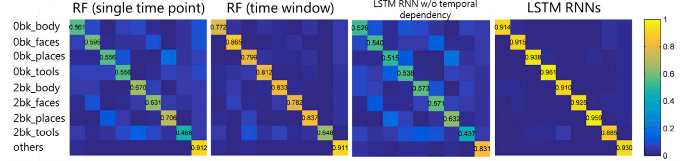

Slide 39
Next is a diagram of activities of hidden cells in the second LSTM layer of one randomly selected testing subject on the working memory task fMRI dataset.

Slide 40
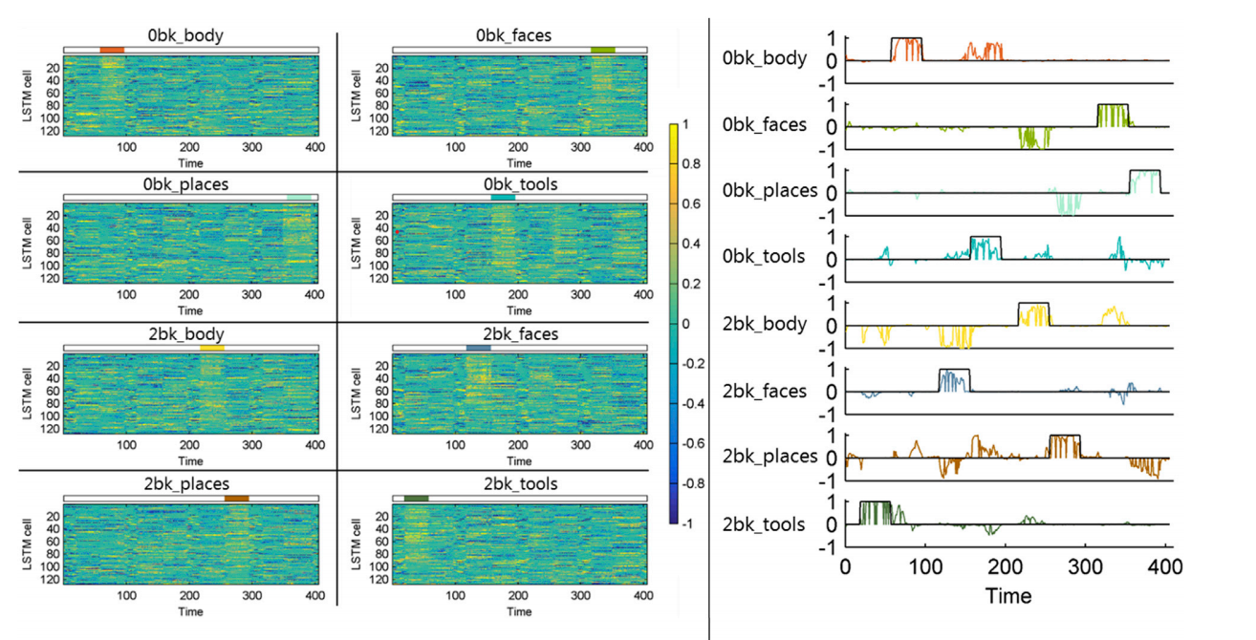
Activities of all 128 hidden cells, the cells in each subplot are shown in descending order according to absolute values of their prediction weights in the prediction model for each task event, the colored block above each subplot indicates the onset interval of each task event, and the colorbar indicates activities (values) of each cell on different time points;
Hidden cells with activities (values) maximally correlated with onset of each task event, the black line indicates the onset of each task event, and the colored curve is the activity of the LSTM hidden cell. The activity (value) of the hidden cell is scaled using its maximal absolute value for the visualization.

Slide 41
Performance analysis of the LSTM RNNs based brain decoding model on working memory task fMRI data.

Slide 42
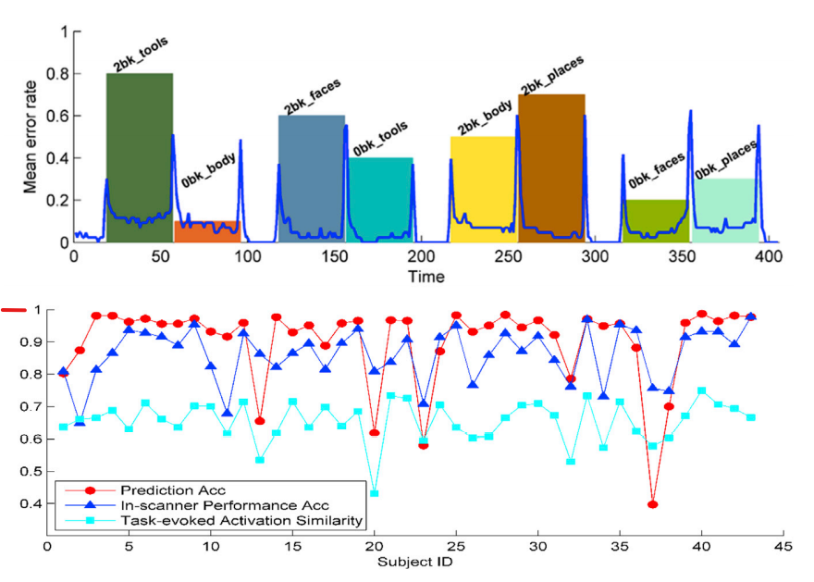
Most of the misclassified time points are located at inter-state regions
The prediction accuracy is significantly correlated with the subjects’ in-scanner performance accuracy and task-evoked activation similarity between training data and testing.

Slide 43
Conclusion
LSTM better distinguished subtly distinct brain states based on task fMRI data than those built using RF
Why - LSTM based brain decoding model extract temporal dependencies and learn the mapping between functional signatures and their corresponding brain states better
It was capable of decoding brain states across different categories of tasks with improved performance.
Computing functional connectivity patterns requires to specify a time window with a certain length to reliably estimate the functional connectivity.
This is not a trivial task to determine an optimal time window
Although the proposed brain decoding method has achieved better performance than RF, further efforts are needed in following aspects.
The brain decoding models were evaluated using block designed. It can be evolved for event designed task fMRI to investigate how the temporal duration of brain states impact the decoding performance.
FNs at a single spatial scale were used to compute functional signatures for the brain decoding.

Slide 44
Thank you
Any more questions?

